Slide 1
TARIFFS AND THE COUNTRIES THAT COULD BE IMPACTED BY THEM BY EXAMINING PORT DATA
Issac Thomas
MSDS 570 Visualization and Unstructured Data Analysis
12/7/2024

Slide 2
Problem/Question President-Elect Donald Trump has proposed imposing steep tariffs on imports. A potential 10-20 percent tariff on all imports at least a 60 percent tariff on Chinese imports, and a 25-100 percent tariff on Mexican imports. Purpose The purpose of this presentation is to explore some of the of top international ports and respective countries based on volume that could potentially be impacted by proposed tariffs. Objective Is to become familiar with what countries are the top imports and exporters and get an intuitive sense of where goods could be more expensive.

Slide 3
EDA Data Set Overview
Daily-Port-Activity-Data-and-Trade-Estimates obtain from Kaggle with a focus on activity between 2023 to 2024 to narrow the scope.
Variables used for KPI’s
Exports
Imports
Countries
Size and Scope
The dataset provided 29 columns of varying port activity measurements. There was a generous number of observations with 3,486,152 rows total. Additionally, the data captured daily activities for 180 countries and 1,620 ports.

Slide 4
Preprocessing
Dataset reduction by filtering for years 2023 to 2024
Drop of date column
Review of missing values
Key Performance Indicator Development
Fortunate enough to have clean data!
Project Tools
Visual Code Studio
Python Libraries
Pandas
Seaborn
Matplotlib
Numpy
Scipy

Slide 5

TARIFF OVERVIEW
UNDERSTANDING TARIFFS
Tariffs are taxes imposed on imported goods. They serve to protect domestic industries and generate revenue for governments. Tariffs can alter trade balance and influence economic relations.

Slide 6
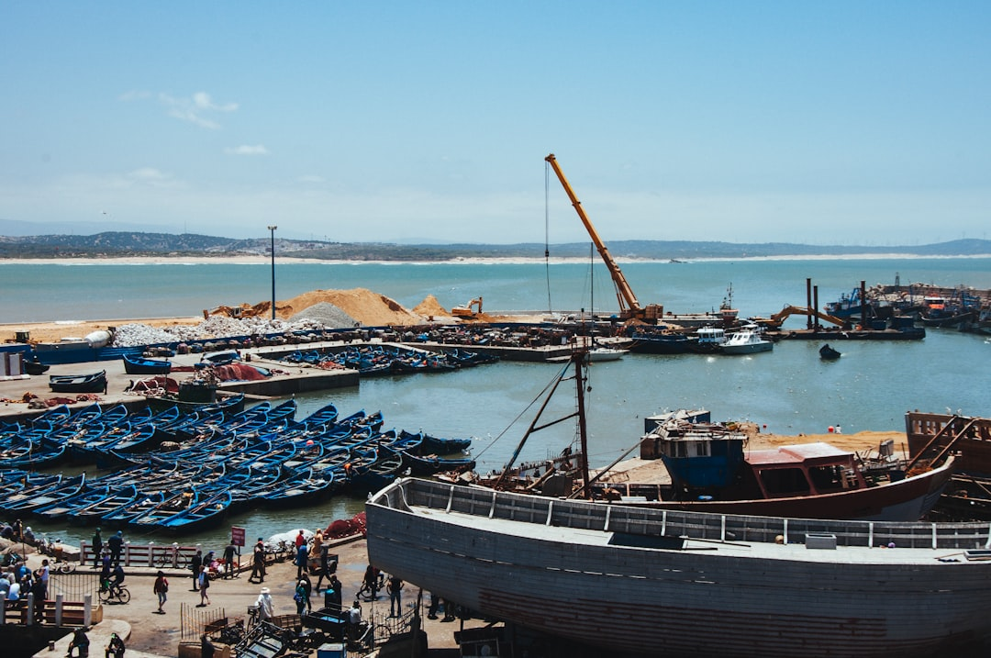

IMPACT ON PORTS
LOGISTICAL CHALLENGES
Tariffs disrupt supply chains, causing delays. Ports must adapt to changing trade regulations and compliance, which may require additional resources.
ECONOMIC EFFECTS
Tariffs can increase shipping costs, impacting port profitability. Higher tariffs can lead to reduced cargo volumes and changes in shipping routes.

Slide 7
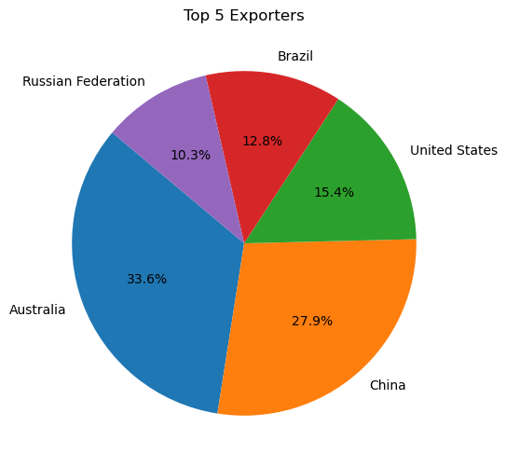
Top 5 Exporters on an Export Value Basis
As depicted in the Pie Chart, Australia and China are the largest exporters in the world from a port standpoint.

Slide 8
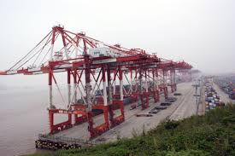
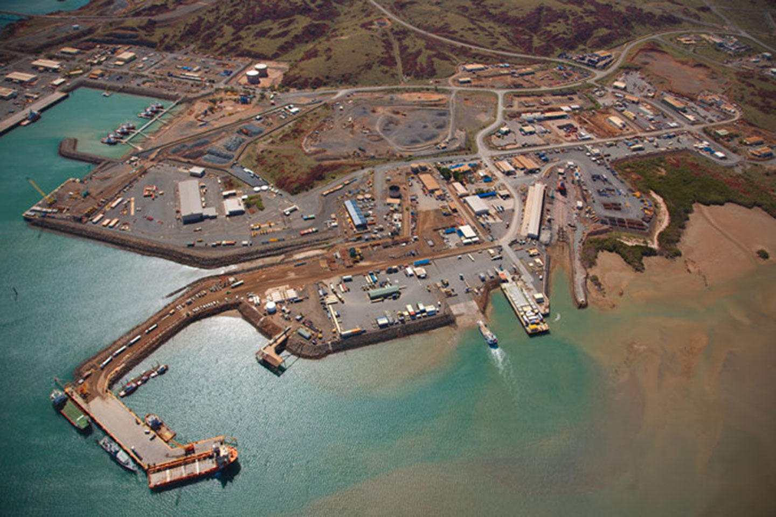
What Does the US Purchase from the Top Two Exporters
Australia
Agricultural products
In 2021, agricultural products were the top commodity sector imported from Australia, making up 28.5% of the total imports
Stone, glass, metals, and pearls
In 2021, stone, glass, metals and pearls made up 18.4% of the total imports from Australia
Chemicals, plastics, rubber, and leather goods
In 2021, chemicals, plastics, rubber, and leather goods made up 12.9% of the total imports from Australia
China
Machinery and mechanical appliances
In 2022, this sector accounted for 46.4% of all U.S. imports from China.
Furniture, bedding, lamps, toys, games, sports equipment, paint, and other miscellaneous manufactured items
In 2021, this sector was the main source of U.S. imports from China.
Chemicals, plastics, rubber, and leather goods
In 2022, this sector accounted for 12.0% of all U.S. imports from China.

Slide 9
ECONOMIC CONSEQUENCES
This data was not apart of the project dataset. However, it is included to give peripheral context of the tariff influence.
The economic impacts of tariffs on major international ports are significant. Changes in trade volume can affect local economies, employment, and port infrastructure investments.
PORT | ECONOMIC IMPACT | TRADE VOLUME CHANGE
Port of Los Angeles | -$200M | -15%
Rotterdam Port | -$150M | -10%
Singapore Port | -$120M | -5%
Hamburg Port | -$100M | -12%

Slide 10
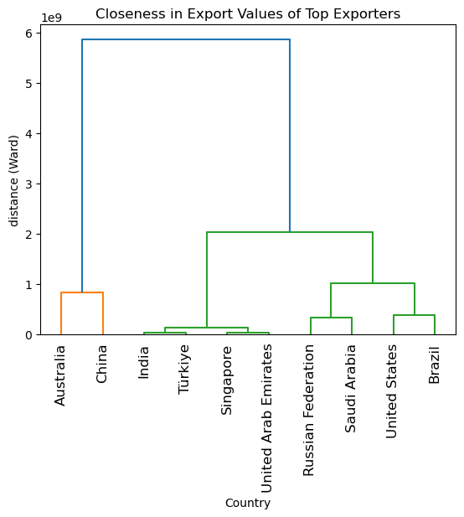
Insights
Australia is larger exporter than expected.
The US is more on par with Brazil as it pertains to Export values.
The impact the tariffs on China goods would be significant.

Slide 11
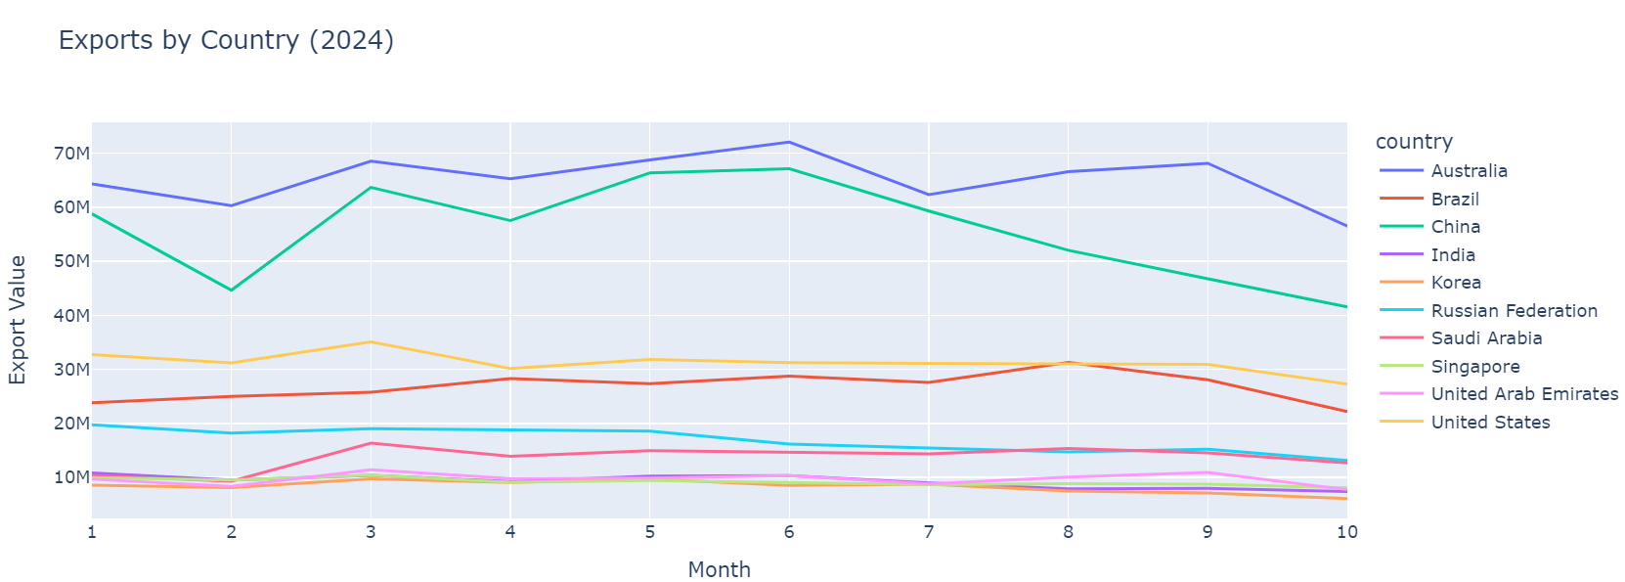
Top Exporters 2024
As depicted in the line chart, Australia and China has remain amongst the top exports in the world. In comparison US is middle of the pack within the top 5.

Slide 12
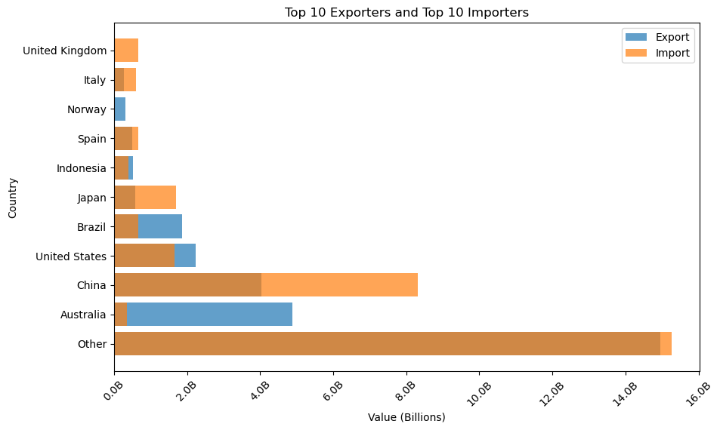

Slide 13
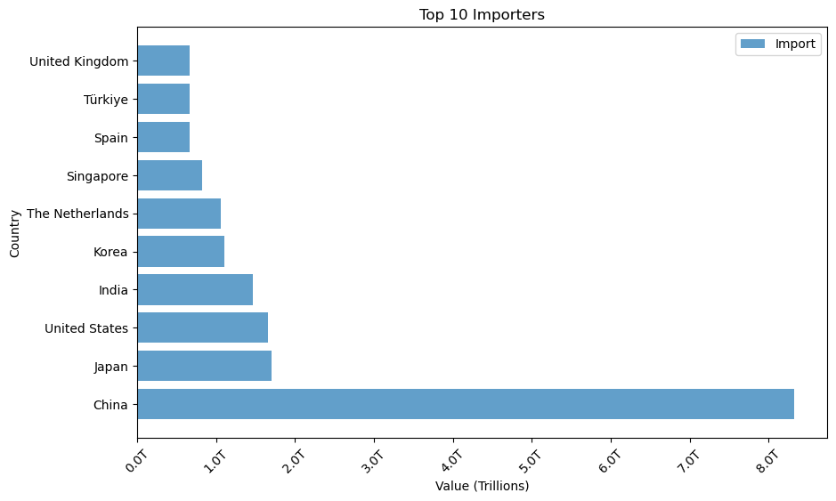

Slide 14
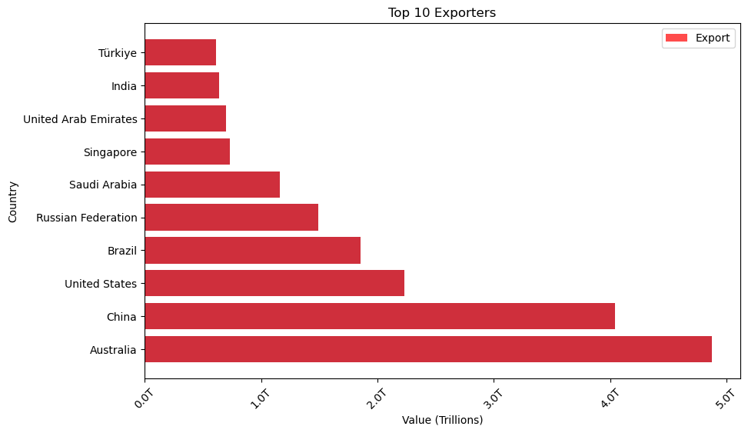

Slide 15

MITIGATION STRATEGIES
Offering additional services can help ports offset losses from tariffs. This may include logistics support, warehousing, and value-added services to remain competitive.
OPERATIONAL EFFICIENCY
Ports can streamline operations to reduce costs and maintain profitability despite tariffs. Investments in technology and better logistics are crucial.

Slide 16
Conclusion
The magnitude of the tariffs cannot totally be recognized at this time. However, the impact is sure to be noticeable amongst some of the world’s top exporters and import. The long-term implications of tariff policies on international trade and port activity could mean higher costs of goods and lost jobs.
From the vantage point of the United States, onshoring of products is a necessity as it is lagging in its exports in comparison to countries such as Australia and China. Future trade relationship will be tested if said tariffs take affect.

Slide 17
References
Office of the US Trade Representative
https://ustr.gov/countries-regions/southeast-asia-pacific/australia#:~:text=U.S.%20goods%20and%20services%20trade,was%20%2427.1%20billion%20in%202022.
Port Watch
https://portwatch.imf.org/datasets/75619cb86e5f4beeb7dab9629d861acf_0/explore?showTable=true
Polifact
https://www.politifact.com/article/2024/dec/02/can-donald-trump-enact-tariffs-on-his-own-and-can/
Bureau of Industry and Security
https://www.bis.doc.gov/index.php/documents/technology-evaluation/ote-data-portal/country-analysis/2998-2021-statistical-analysis-of-u-s-trade-with-australia/file#:~:text=In%202021%2C%20of%20$12.5%20billion,and%20Leather%20goods%20(12.9%25).

Slide 18
Challenges
Had to pivot on the project topic several times due to data availability issues.
Dataset was too large for my device which prevented certain visualizations.
Had to select less sophisticated visualizations due to needed data attributes were unavailable for certain visuals
Consolidating this topic into feasible presentation length

Slide 19
Q&A

